Slide 1
Patient Pathway
Autoimmune Hepatitis (AIH)
ORPHACode: 2137

Slide 2
Pre-diagnosis
Diagnosis
Management
Follow-up
First symptoms
Diagnosis
Medication
My daily life
Assessment
Treatment Response
Doctor‘s visit
Measuring liver damage
Selfcare
Questions for the doc
Screen for additional autoimmune disorders
Complications
Screen for complications
Ongoing research
Content last updated in 12.2025

Slide 3
Disclaimer: No liability for errors.
This pathway has been created to aid doctors and patients make decisions in specific situations. They are based on scientific findings and proven procedures but should also take economic aspects and individual differences into account. This pathway is not legally binding for doctors.
This patient pathway is intended as a general guide to support doctors and patients in making informed decisions in specific situations. While it is based on scientific findings and established procedures, it should always be considered alongside individual patient circumstances, clinical judgment, and economic factors. Every case is unique, and treatment decisions should be tailored accordingly.
This pathway is not legally binding for healthcare professionals and does not replace personal medical advice or professional judgment. While every effort has been made to ensure accuracy, no liability is accepted for any errors, omissions, or outcomes resulting from the use of this pathway.
For personalised medical advice, patients should always consult their healthcare provider.

Slide 4
Diagnosis
What is Autoimmune Hepatitis (AIH) ?
Autoimmune Hepatitis (AIH) is a rare, chronic (often lifelong) disease, which is characterized by the immune system - the body's natural defense against infections - mistakenly attacking the liver. It affects fewer than 1 in 2000 people. This causes liver inflammation (hepatitis), which, if left untreated, can damage the liver over time.
Liver inflammation means the activation of immune cells in the liver and attacking healthy liver tissue. This process can intensify over time if left untreated and cause liver damage.
Although the exact cause is not fully understood, AIH is not caused by alcohol, lifestyle choices or a viral infection, and it is not contagious—you cannot catch it or pass it on to others. It is believed to be linked to a combination of genetic and environmental factors.
With early diagnosis and proper treatment, AIH can be well controlled in most patients, and most people with the condition lead full and active lives.

Slide 5
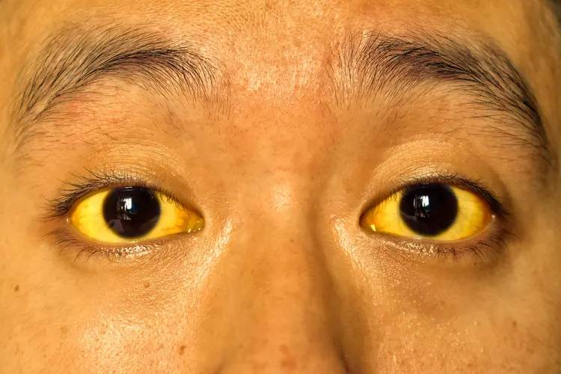
Pre-diagnosis
First symptoms
First symptoms of AIH can start at any age, ranging from early childhood until elderly patients.
About 25% of patients with AIH may not have any symptoms, while others may experience severe ones
Most common is a slow onset of symptoms over several months.
Symptoms often remain vague, making a diagnosis more difficult.
Often AIH is discovered by chance due to elevated liver values in a blood test.
Symptoms may include:
  Fatigue
  Drowsiness, feeling unwell
  Joint pain
  Abdominal pain/discomfort
  Itching of the skin, sometimes all over the body
  Yellowing of the skin and eyes (jaundice)
  Fever
Jaundice
Source: Zay Nyi Nyi/Dreamstime

Slide 6
Pre-diagnosis
First symptoms
The ongoing liver inflammation in AIH can cause scarrring of the liver if left untreated. In clinical practice, a reversible form of scarring (fibrosis) is differentiated from irreversible liver damage (cirrhosis).
Liver cirrhosis is the final stage of a chronic liver disease. In cirrhosis, the liver becomes damaged and deformed due to scar tissue replacing large parts of the healthy liver. (See Figure )
As the onset of AIH can go unnoticed, about one-third of patients with AIH already have liver cirrhosis at the time of diagnosis. Your doctor will check for the presence of cirrhosis during the diagnostic workup.
Healthy liver
Liver cirrhosis
Source: Servier Medical Art (https://smart.servier.com), licensed under CC BY 4.0 (https://creativecommons.org/licenses/by/4.0/).

Slide 7
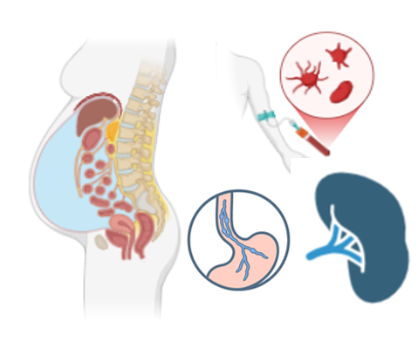
Pre-diagnosis
First symptoms
Cirrhosis leads to a reduced liver function, making it harder for the liver to remove toxins from the blood, process nutrients and produce important proteins.
A common complication of liver cirrhosis is portal hypertension. The portal vein is a major blood vessel carrying blood from the intestines to the liver. Cirrhosis can impair the regular blood flow, leading to increased pressure in the portal vein. Associated complications can include:
Ascites: Formation of free fluid
in the abdominal cavity.
Varices: Enlarged veins, mainly in
the esophagus and stomach which
can cause bleedings.
Splenomegaly: Increase in size of the spleen.

Slide 8
Blood testing
Exclusion of other causes of liver disease
Diagnosis
Drug induced liver injury (DILI)
Variant Syndromes
Liver biopsy
Specific Questions about my diagnosis

Slide 9
Diagnosis
Blood testing
With a simple blood test, it is possible to test for various substances in the blood that allow doctors to assess ongoing liver damage and inflammation.
ALT (= GPT) and AST (= GOT): transaminases are enzymes found inside liver cells (hepatocytes). In AIH, the liver inflammation causes damage to hepatocytes, causing the enzymes to leak into the blood, which makes their levels rise and measurable in the blood. Transaminases are markers for ongoing inflammatory activity of AIH.
IgG: A type of protein produced by immune cells to fight infections (antibody). Increased IgG levels reflect ongoing immune activity and are used as a marker for disease activity.
Autoantibodies: Antibodies that don’t target bacteria, viruses or other infectious pathogens but healthy tissues in the body. Autoantibodies often occur in a wide range of autoimmune diseases, such as AIH. Common abbreviations of different autoantibodies you might find in your lab results include ANA, SMA, LKM and SLA/LP. Some autoantibodies can also be present in healthy people, so the presence of autoantibodies can make the diagnosis of AIH more likely, but doesn’t prove it. At the same time, autoantibodies can also be absent upon diagnosis of AIH.
AIH can be classified into types 1-3 based on the autoantibodies present, although different types usually do not imply differing diagnostic or therapeutic approaches.

Slide 10
Diagnosis
Exclusion of other causes of liver disease
When blood testing reveals elevated liver values, there are several possible causes apart from AIH. Before making the diagnosis of AIH, it is therefore important to rule out other causes of liver disease, mostly using simple blood tests. Other causes of liver disease include:
Viral hepatitis: Most commonly hepatitis A, B, C, E and EBV (= infectious mononucleosis, “mono”, Epstein–Barr virus).
Steatotic liver disease („fatty liver disease”): a condition where fat builds up in the liver and causes inflammation, which can damage liver cells. The reason for fat accumulation can be alcohol and/or conditions such as diabetes or obesity.
Rare metabolic/genetic diseases: M. Wilson (copper overload causes liver damage) and haemochromatosis (iron overload causes liver damage).
Sometimes the distinction between AIH and other liver diseases can be difficult at the time of diagnosis. This is particularly true for drug induced liver injury (DILI) and variant syndromes with features of other autoimmune liver diseases (view next pages).

Slide 11
Diagnosis
Drug induced liver injury (DILI)
DILI means liver damage by a medication, herbal supplement, or other chemical substance. This can cause acute liver inflammation very similar to the acute onset of AIH and at times can be difficult to distinguish.
Common trigger substances include antibiotics, pain killers, dietary supplements and a wide range of other medications.
Your doctor will ask whether you have started a new medication or dietary supplement before the first occurrence of elevated liver values. If not, this makes the diagnosis of AIH more likely.
Most people fully recover once the drug is stopped. Contrary to AIH, there is usually no need for medical treatment over a longer period of time.

Slide 12
Diagnosis
Variant syndrome
While in AIH the liver inflammation affects the liver cells, in other autoimmune liver diseases the inflammation can also affect the cells lining the bile ducts (cholangiocytes). If the very small bile ducts are affected, this disease is called Primary Biliary Cholangitis (PBC) and in case of large bile duct involvement, this is called Primary Sclerosing Cholangitis (PSC). In some cases, signs of PBC and PSC can occur in AIH patients. An PSC-AIH variant occurs more often in children and young adults.
Your doctor will suspect a possible variant syndrome (previously called „overlap syndrome“) of PBC-AIH or PSC-AIH based on blood values indicating cholestasis / bile duct involvement and/or persisting symptoms such as jaundice and pruritus.
If PBC-AIH variant syndrome is suspected, autoantibodies such as AMA being specific for PBC can be detected.
If PSC-AIH variant syndrome is suspected, usually a magnetic resonance cholangiopancreatography (MRCP) is recommended. This is a type of MRI scan that highlights the bile ducts in the liver and can detect blockages or narrowing causing cholestasis.

Slide 13
Diagnosis
Liver biopsy
Liver inflammation in AIH follows a typical pattern with several important signs. This can only be identified by a pathologist examining liver tissue under a microscope. The intensity of the liver inflammation can be scored, as well as the degree of scarring (fibrosis) of the liver tissue. Also signs of possible other liver diseases could be identified.
A liver biopsy is a mandatory part of the diagnostic workup when first diagnosing AIH. The procedure is usually performed under local anesthesia and light sedation, depending on the method of biopsy. The most commonly used procedures for liver biopsy are an ultrasound-guided or a mini-laparoscopic liver biopsy. (See Figure)
A mini-laparoscopic liver biopsy is a short procedure where a small camera and instruments are inserted through small cuts in the abdomen to take a sample of liver tissue. This allows to examine the liver directly, to control for possible adverse events of the liver biopsy such as bleeding and remove a small liver sample safely for further examination under the microscope.
Transjugular liver biopsy: Patients will lay on their back on an X-ray table. The doctor will use ultrasound to locate the jugular vein, numb the area, and insert a thin tube. X-rays will guide the doctor in taking 1 to 3 liver tissue samples. Afterwards, the tube is removed, and a bandage is placed on the small cut.
Percutaneous liver biopsy: The doctor will use ultrasound to guide the procedure, clean the area, numb it, and make a small incision. A biopsy needle will be inserted to collect tissue samples quickly, and a bandage will cover the incision.
The choice of biopsy method depends on patient-related factors (e. g. BMI, prior abdominal surgery) as well as the local experience of your treating medical center. In general, all methods have a similar safety profile.

Slide 14
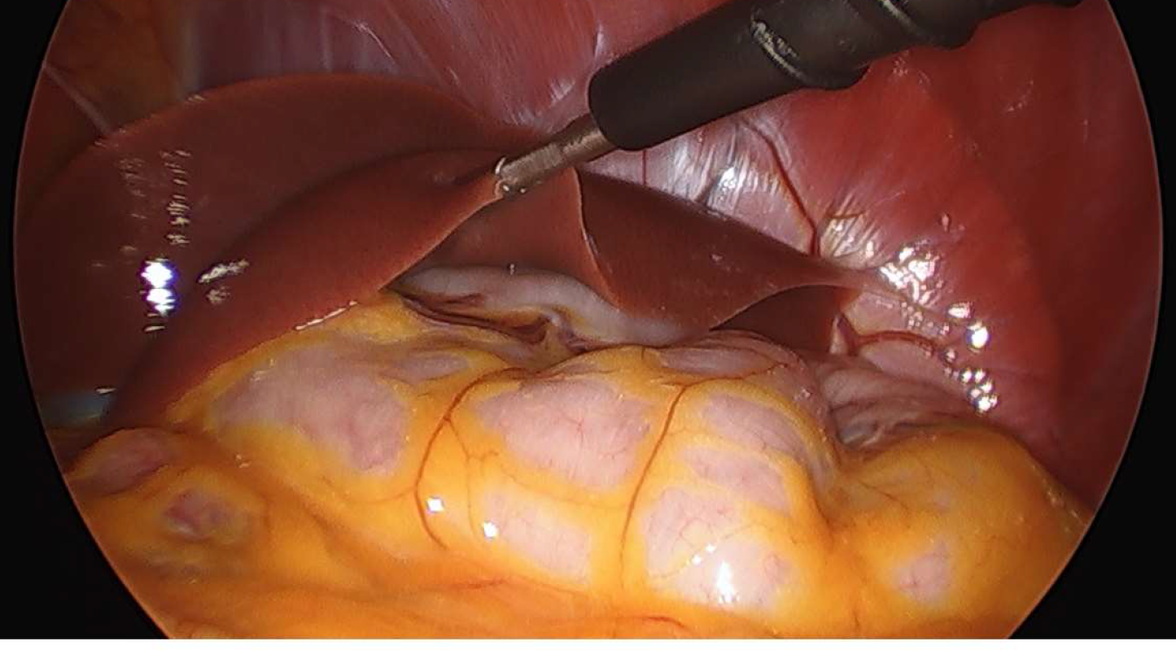
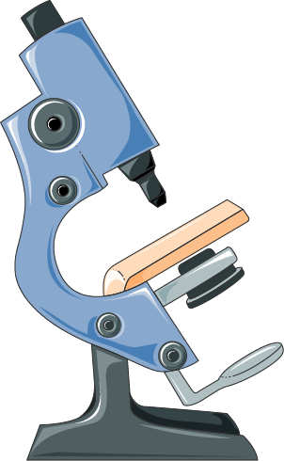
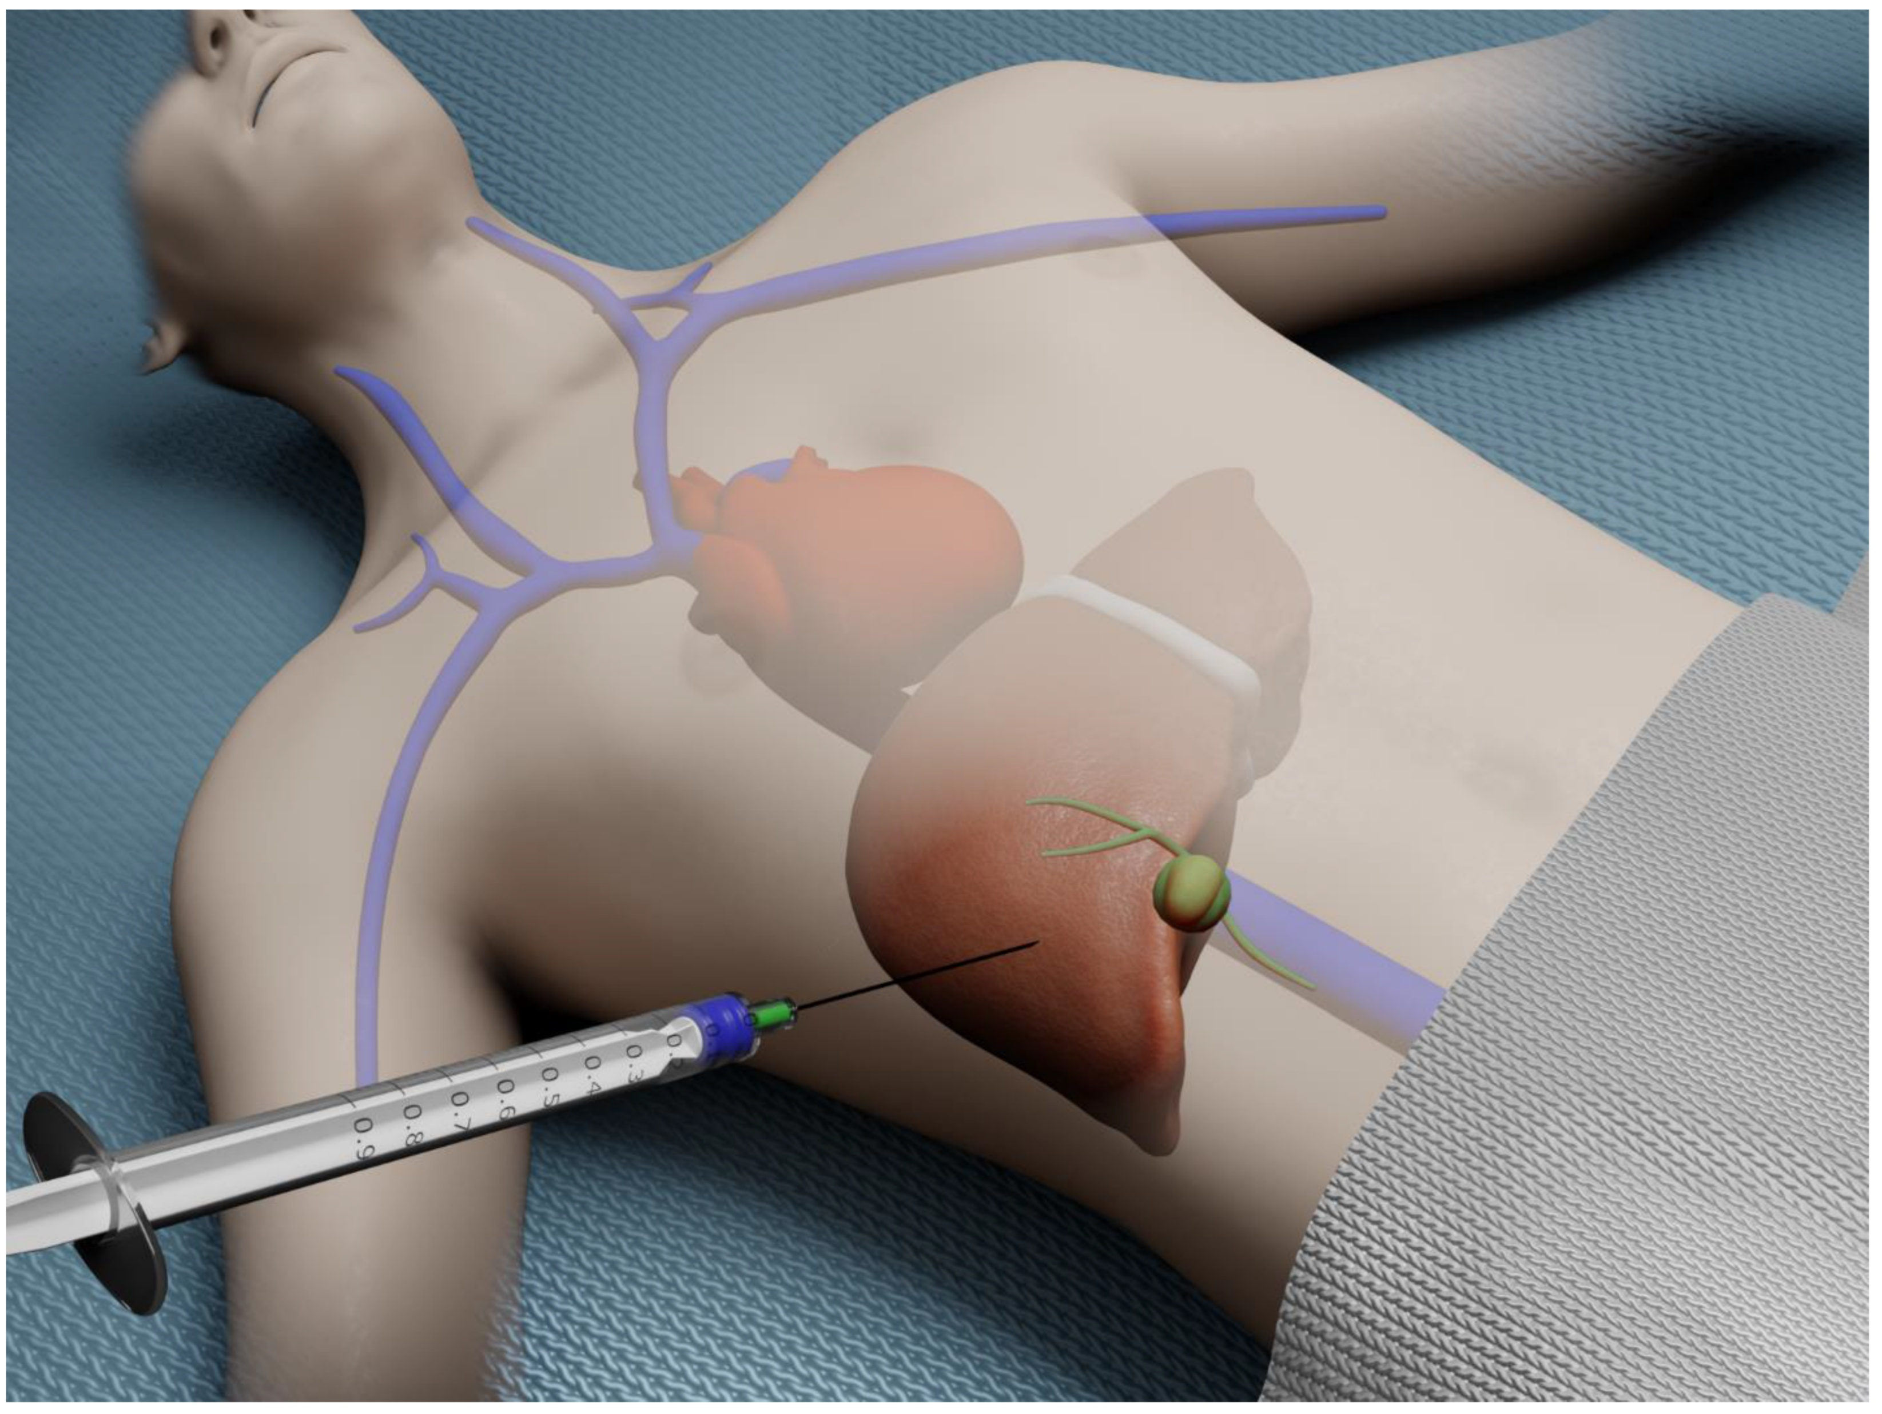
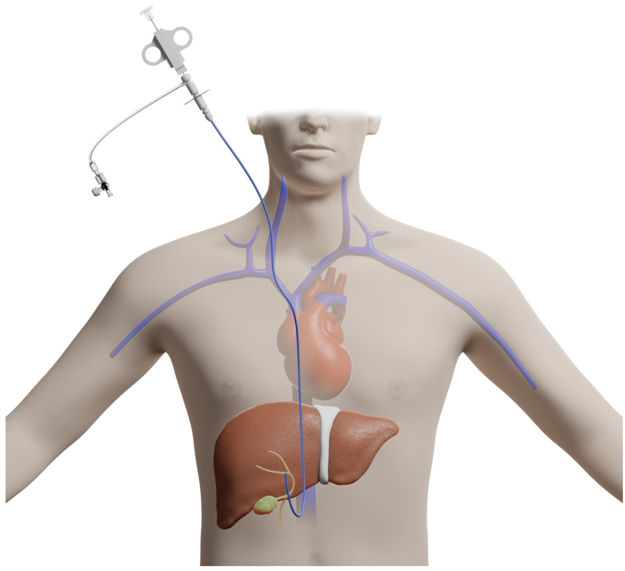
Diagnosis
Variant syndrome
Liver biopsy via mini laparoscopy
Percutaneous/ ultrasound-guided liver biopsy
Evaluation of the liver sample under the microscope
(plus doctor’s evaluation of clinical signs)
Diagnosis of AIH
Transjugular liver biopsy
Sources: Ramai et al. Advances in Endoscopic Ultrasound (EUS)-Guided Liver Biopsy. Diagnostics 2023, 13, 784; Derby et al. SIV Infection Is Associated with Transient Acute-Phase Steatosis in Hepatocytes In Vivo. Viruses 2024, 16, 296; Servier Medical Art (https://smart.servier.com), licensed under CC BY 4.0 (https://creativecommons.org/licenses/by/4.0/).

Slide 15
Diagnosis
Specific Questions about my diagnosis
Why did I get this disease?
The reason why AIH occurs in some people and not in others to date cannot be sufficiently answered on an individual level. As for many autoimmune diseases, a multitude of factors including genetics and environmental factors can promote the onset of AIH, but the exact mechanisms to date are unknown.
Why didn’t I feel any pain?
The liver itself has very few nerve endings transmitting pain signals. Even when the liver is inflamed, pain is usually absent.
Will this disease affect my daily life?
Key factors that may influence the daily life are the extent of liver damage at the time of diagnosis, the response to and possible side effects of the treatment and whether there are any complications. With proper management, AIH patients have the same life expectancy as healthy people. Lifelong follow-up is essential to monitor the condition, which includes regular blood tests and liver stiffness measurements.

Slide 16
Diagnosis
Specific Questions about my diagnosis
Will liver cirrhosis develop from AIH?
With proper management, liver damage can be prevented in many AIH patients. However, this depends on the individual response to immunosuppressive therapy and adequate follow-up visits.
Why did it take so long and so many doctors to get the diagnosis?
AIH is a rare disease, and some doctors might not be familiar with this entity. It is important to be referred to a specialist centre with medical staff experienced with the diagnosis and management of this disease.
Will I have to take medicine for the rest of my life?
AIH is a chronic condition. Currently, there is no treatment that can cure the disease. The immunosuppressive medication suppresses the liver inflammation to prevent further liver damage and is usually a lifelong requirement for AIH patients. However, in a small group of carefully selected patients with a long time of remission (about 2-3 years and more), a trial of stopping treatment can be considered. Relapses of AIH during cessation of the immunosuppressive medication do occur and usually lead to treatment with steroids before re-starting the long-term immunosuppression. The risk for and time of a relapse currently can’t be accurately predicted and is investigated in ongoing research trials.

Slide 17
Non-invasive liver stiffness measuring (elastography)
Measuring liver damage
Assessment
Screen for additional autoimmune disorders
Screen for complications

Slide 18
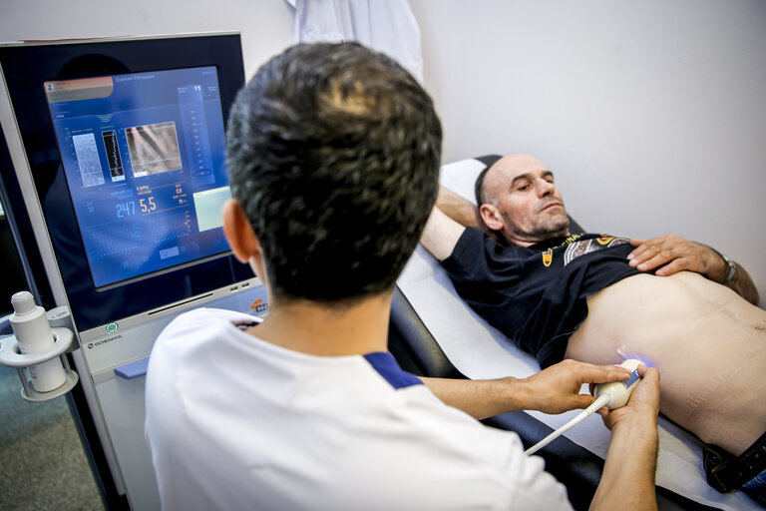
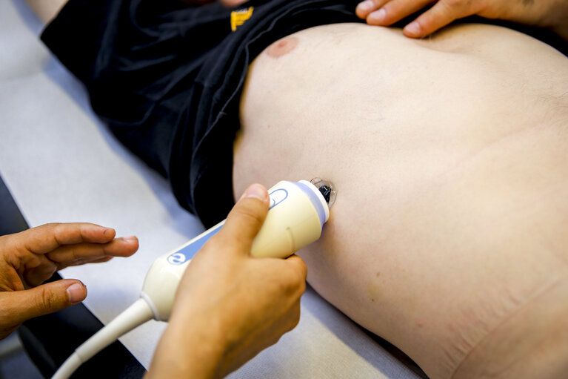
Assessment
Measuring liver damage
Non-invasive liver stiffness measurements (elastography):
Elastography is a non-invasive test that measures liver stiffness by sending a painless vibration (shear wave) through the liver and measures how quickly it travels. Liver stiffness measurements can provide important information on the degree of liver scarring (fibrosis) and serves for monitoring liver fibrosis and as an important parameter of treatment success.
An additional measurements of elastography quantifies the fat content of the liver cells. A high amount of fat in liver cells can also lead to liver damage in the long term and thus needs to be addressed. An elevated fat content is often linked to obesity, a diet rich in (saturated) fatty acids, alcohol use as well as certain medications and other metabolic disorders.
Elastography can also be applied to the spleen, which can provide information about the presence of portal hypertension.
Source: European Parliament, Multimedia Centre. Reference: EP-055469A, Photographer: Arnaud DEVILLERS

Slide 19
Assessment
Screen for additional autoimmune disorders
Up to 20% of AIH patients have another autoimmune condition when diagnosed, and 13% develop one within 5 years
The most commonly associated autoimmune diseases are:
  Thyroid disease (hypo- or hyperthyroidism)
  Skin diseases (vitiligo, psoriasis)
  Coeliac disease (especially in children)
  This is why your doctor will screen for these conditions at diagnosis and during follow-up and order additional tests if needed, based on clinical findings upon (first) presentation and routine blood tests. For example, symptoms like chronic diarrhea (coeliac disease), a systematic examination of pruritus (psoriasis) or routine blood tests (thyroid) may hint at an additional autoimmune condition.

Slide 20
Assessment
Screen for complications
AIH can cause complications. These complications have to be detected as early as possible to take preventive measures to avoid further problems.
It is important to maintain clear and constructive communication, adhere to the prescribed treatment, and schedule regular follow-up visits with your treating physician to monitor for any complications that may arise.
Complications may include the presence of liver cirrhosis and portal hypertension, which can be detected via clinical signs, blood tests, liver biopsy or elastography. Additional investigations may be performed in case of clinical suspicion.
Suspected treatment-related complications should be discussed with the treating physician and may lead to a change in medication.

Slide 21
Medication
Treatment Response
Management
Pregnancy
Selfcare
Ongoing research

Slide 22
Management
Medications
Steroids
Azathioprine or MMF
Blood tests
2
4
6
8
10
12
24
Diagnosis
weeks
The main goal of any first-line AIH treatment is achieving remission (= no measurable disease activity, = inactive disease), defined by normalization of ALT, AST and IgG.
Blood tests might occur more frequently than indicated here, depending on the choice of and response to treatment.
In case of no remission, a 2nd or 3rd line therapy can be considered. Your physician will discuss the progress and response to the ongoing treatment with you during your follow-up appointments.
Modified based on EASL guidelines for Autoimmune Hepatitis, Journal of Hepatology, August 2025.

Slide 23
Management
Medications
AIH is an autoimmune disease in which the immune system attacks the liver. Immunosuppressants are a class of drugs that reduce inflammation by inhibiting certain mechanisms and cells of the immune system. Due to the chronic nature of AIH, a long-term, in most cases lifelong treatment is recommended.
Different immunosuppressants are available for the treatment of AIH. The choice of medication depends on individual factors such as prior medical history, family planning and stage of liver disease. The choice and dosage of immunosuppressants will be adjusted according to individual needs and response to treatment.
Upon diagnosis, patients are usually started on steroids which are effective immunosuppressants that usually leads to a timely improvement of liver values. Then, another immunosuppressant is usually added that is better suited for long term therapy. Due to side effects, the aim for treatment is to gradually wean out steroids while maintaining normal liver values reflecting absence of disease activity.
Consistency is key: Take your medication exactly as prescribed and regularly. In case of side effect, address your treating physician timely since there are many alternative immunosuppressants that can be used for the treatment of AIH.

Slide 24
Management
Medications
Steroids
Steroids (e. g. prednisone, prednisolone) can quickly reduce acute liver inflammation in AIH. In case of strong inflammatory activity in AIH, steroids are started usually with a higher dose. Over time, the dose will be gradually reduced and steroids will be replaced by other drugs due known side effects of a long-term therapy.
Budesonide is a steroid that has an effect primarily in the liver and few systemic side effect. Budesonide cannot be given at the stage of liver cirrhosis due to increased rates of side effects.
Common side effects may include:
  High blood sugar (diabetes)
  High blood pressure
  Weight gain
  Sleeplessness (insomnia), Depression, impaired concentration, psychosis
  Osteoporosis (reduced bone density, increasing the probability of bone injuries)
  Due to the side effects, steroids are usually considered unfavorable for long-term therapy but are required to effectively treat episodes of acute liver inflammation.

Slide 25
Management
Medications
Thiopurines (azathioprine, mercaptopurine)
First choices for long-term maintenance therapy of AIH due to their effectiveness in maintaining long-term remission. It is taken as a daily pill. Mercaptopurine is an alternative if side effects develop under azathioprine.
There can be marked differences in individual processing of thiopurines. This usually makes it necessary to adjust the dosage to the individual patient. Thiopurine levels can be measured in blood samples, which can be used to find the right dosage for treatment.
Thiopurines are considered safe during pregnancy and lactation and thus thiopurine therapy is the first choice for treatment of AIH during pregnancy.
Potential side effects of thiopurines include (among others):
  More frequently: Nausea, vomiting or stomach pain
  Increased risk for infections
  Increased risk for non-melanoma skin cancer
  In rare cases: inflammation of the pancreas (acute pancreatitis)
  In rare cases: Bone marrow toxicity with a rapid decline of white blood cells in peripheral blood
  Doctors usually monitor blood and liver tests regularly to detect side effects early. Annual dermatological and gynecological check ups and vaccinations are usually recommended under thiopurine therapy.

Slide 26
Management
Medications
Mycophenolate mofetil (MMF)
MMF is an alternative for azathioprine as a first-line therapy and an effective immunosuppressant in AIH. It is usually taken as a pill twice daily.
Common side effects may include:
  More frequently: Nausea, diarrhea or stomach upset
  Reduction in white and/or red blood cells and platelets
  Increased risk of infections
  Impaired wound healing
  MMF can harm an unborn baby. Therefore, MMF must not be taken during pregnancy. Women and men planning to have children and who are under MMF Treatment must use contraception.
  MMF should not be taken during breastfeeding. For alternatives, please consult your treating physician.
  MMF therapy should be monitored with regular blood tests.

Slide 27
Management
Medications
Other medications
A minority of people with AIH does not respond to standard therapy with azathioprine or MMF. In these cases, the therapy is switched to a different medication entirely or another medication is added to the treatment plan. These medications (so-called second and third-line treatments) are applied as an off-label usage, which means that these medications were not officially approved for treating AIH.
Expert centres for autoimmune hepatitis have experience with these treatments and will discuss with you in detail which medication might be suitable for you. The decision for a second- and/or third-line treatment depends on your individual situation and the recommendations and experiences of your treating centre. You will receive detailed information about the available drugs, such as tacrolimus, infliximab, rituximab and others. Of note, only a minority of people with AIH required second- or third line treatments.
Some of these medications are administered intravenously over 1-2 hours in an outpatient setting.

Slide 28
Management
Treatment response
Response to treatment in AIH is usually evaluated based on blood tests. A complete remission (= no measurable disease activity) is defined by normalization of ALT, AST and IgG (for further explanation see above).
In selected cases, a trial of treatment withdrawal can be discussed with the patient. The patient needs to informed that the risk of a relapse of AIH after treatment withdrawal is relatively high and can occur shortly or even years after weaning out immunosuppressants. Before treatment withdrawal, transaminases need be in normal range for at least two years. If you wish to reduce the dosage or cease your medication, you should consult with your treating physician if that is possible.
A relapse is an episode in which the disease becomes active again after it was under control. This can occur after changes in treatment or even under continued therapy in case of an aggressive form of AIH. A relapse usually requires an adjustment of your current medication.

Slide 29
Management
Complications
Complications during AIH treatment may arise due to side effects of the medication or an insufficient control of disease activity. That is why particularly when starting a new medication, close monitoring via blood tests and regular clinical visits are needed to anticipate and/or prevent possible adverse events.

Slide 30
Management
Pregnancy
As AIH can occur in patients of all age groups, it can affect women of childbearing age. In pregnancy, AIH requires close monitoring by a medical team of experienced specialists including obstetricians and hepatologists. In general, treatment of AIH with azathioprine is considered safe during pregnancy and lactation and should be continued. A greater risk for the baby and the mother derives from an uncontrolled flare of AIH in case of stopping treatment during pregnancy.
Mycophenolate mofetil (MMF) can pose a severe risk to the unborn child and should be withdrawn several months before conception. During an ongoing treatment with MMF, appropriate contraception is clearly recommended.
You should discuss your family planning with your doctor early after the diagnosis in order to avoid unnecassary changes of treatment.
If you are actively trying to conceive, you should schedule an appointment with your doctor beforehand and discuss 1) any existing impairments of liver function or signs of chronic liver damage and the associated risk in pregnancy, 2) the current effectiveness of your therapy (stable remission vs. signs of ongoing AIH acitivity) and 3) the safety of your medication, as some medications like MMF require a withdrawal months before conception.
The typical time of a flare of AIH is usually not during pregnancy, but in the weeks and months after childbirth.

Slide 31
Management
Management of complications
Osteoporosis prevention: In some patients, steroids are needed over a prolonged period of time which can increase the risk for existing osteoporosis.
  Osteoporosis is a condition which makes bones more fragile, making them more likely to break.
  Hence, an adequate supplementation of Vitamin D should be considered under long-term corticosteroid therapy to counter the elevated risk for osteoporosis.
  At the time of diagnosis, a dual energy X-ray absorptiometry (DEXA) exam (bone density measurement) is recommended to determine the risk for osteoporosis.
Vaccinations: Under immunosuppressive therapy, an increased risk for more and severe infections is possible. That is why a regular update of vaccinations should be done under treatment for AIH. Recommendations for vaccinations may differ by country. They may include vaccines against viral hepatitis A and B, influenza, Covid-19, shingles, RSV and pneumococcus.
Fatigue: see below.

Slide 32
Management
Selfcare
Patients with AIH should be counselled with regard to maintaining a healthy lifestyle including regular physical activity and balanced food intake.
Based on the individual needs, psychological support should be offered to deal with:
  Living with a chronic and rare disease with the need for lifelong follow-up
  Living with uncertainty since the exact causal factor for the development of AIH is not known and success of treatment in preventing long-term complications is not achieved in every patient
  Exchange of experiences and coping strategies of other AIH patients
Mental health-related symptoms such as depression occur more frequently in patients with AIH and should be screened for.
You might be interested in engaging a national or international patient association. Many patients find benefit in:
  emotional support and contact with other people in similar situations
  practical information about the disease and Orientation in the local healthcare system
  support in patients' rights
  stay up to date with research activities
You can find a list of local patient organisations to contact in your country under the following link: https://rare-liver.eu/patients/patient-organisations/?filter=

Slide 33
Management
Ongoing research
AIH is a rare disease, in which the exact causal mechanisms are unkown. Currently, a treatment that cures the disease is not available. That is why there is an ongoing research effort by multiple groups worldwide to improve our understanding of the disease, to provide more specific treatment and to help to improve patient care. Current projects are e. g. focusing on:
  The immune mechanisms of AIH in humans and animal models.
  Exploring new treatment options for patients who don‘t respond well to the currently used medications.
  Creating databases and patient registries to facilitate access to clinical data in the future.
  Exploring the psychosocial impact of AIH on patient’s lives.
Your physician may inquire about your interest in participating in studies or trials. As research advances, your treatment plan may evolve throughout your care journey.

Slide 34
Follow-up
My daily life
Most patients with well-controlled AIH will have a normal life.
AIH usually requires lifelong follow-up and long-term medication.
Patients with well-controlled AIH can continue their job and participate in social life as usual. They have the same life-expectancy as healthy people.
Patients should have a healthy lifestyle with sufficient physical activity and avoid alcohol and obesity. In some cases, dieticians and physical therapists can provide valuable additional support.
In case of symptoms such as chronic fatigue, some adjustment may be needed.

Slide 35
Follow-up
My daily life
Fatigue
Fatigue (pronounced tiredness and lack of energy) can be a challenging symptom of AIH. Many patients experience persistent exhaustion that does not improve with sleep or rest.
The intensity can vary widely, ranging from mild tiredness to significant limitations in daily life.
Fatigue can also occur when laboratory values are well controlled and does not always reflect current disease activity.
A holistic approach is important in treating fatigue, including optimal control of the underlying disease as well as the identification and treatment of possible other underlying factors (e. g. iron deficiency, anemia, thyroid disorders, sleep problems or depressive symptoms). Many patients also benefit from structured daily routines, good sleep hygiene, regular physical activity and a balanced diet.
If you are experiencing fatigue which affects your quality of life, you should communicate this openly with the healthcare team.

Slide 36
Follow-up
Doctor‘s visit
Autoimmune hepatitis requires lifelong follow-up with clinical visits, regular blood tests and surveillance of liver fibrosis.
Blood tests should be repeated at least every 6 months in a very stable situation, but may be required more frequently depending on the response to treatment.
Shortly after the diagnosis, more frequent doctor visits are needed in order to adjust dosages with the goal of achieving full remission.
In case of already established liver cirrhosis, a more comprehensive follow-up is needed including screening for liver cancer via ultrasound imaging every 6 months.

Slide 37
Follow-up
Questions for the doc
What is my exact diagnosis, and what does it mean for my health?
What are the possible causes of my condition?
What are the treatment options available, and what are their benefits and risks?
What lifestyle changes can help improve my condition?
Are there any side effects or long-term consequences of the treatment?
How will we monitor my progress, and how often should I have check-ups?
Are there any alternative or complementary treatments I should consider?
Are there any clinical trials or new treatments available for my condition?
Will I need a liver transplantation?
How will my condition impact my daily life, work, and long-term health?
Where can I find reliable information or support groups for my condition?

Slide 38
Authors
David Lübbering, ERN RARE-LIVER
Eliezer Zahra Bianco, ERN RARE-LIVER
Marcial Sebode, ERN RARE-LIVER Working Group Lead for Autoimmune Hepatitis
ERN Office
Nagham Issa, ERN RARE-LIVER Project Management
Peer review
Francesca Scarpa, Jeanina Nieuwdorp
Acknowledgement
The figures in this patient pathway were created with BioRender.com

Slide 39


References
EASL Clinical Practice Guidelines on the management of autoimmune hepatitis. Dalekos, George et al. Journal of Hepatology, Volume 83, Issue 2, 453 - 501

Slide 40
For more information, contact us at ern.rareliver@uke.de / rare-liver.eu
Content last updated in 12.2025

